Slide 1
Wine Tasting Note Generator
A NLP Language Generation Model

Slide 2
Table of Contents
01
Problem Statement
05
Model Evaluations
02
Dataset Sources
06
Flask Deployment
03
Data Cleaning & EDA
07
Conclusions
04
Models Created

Slide 3
Problem Statement
- A large grocery store conglomerate has hired our company to try to find a way to create bulk tasting notes for mass market wines in a believable manner that would be related to an initial given description
- The average consumer still relies heavily on wine tasting notes in decision making and having a brief description next to the bottle can drastically increase the chance of a sale
- Wine notes can be difficult for the average consumer to parse, given writers usually use litter them with personal experience and their own distinct vocabulary

Slide 4
Model Goals
The goal of the model is to create believable, understandable, succinct wine notes from a more standardized and common vocabulary of wine descriptors
An initial seed text will be used to help guide the model on along the right description of the wine
Model evaluations would be mainly done by human rating but would also be scored for Bleu and Rouge

Slide 5



Data Sources
Data was extracted from Tasting Notes from the following sources:
Wine Spectator Top 100 Wines
Wine Advocate/Robert Parker
Vinous
Scrapped over 80,000 Tasting Notes

Slide 6
DATA CLEANING
1. Remove Duplicates
Duplicate Tasting Notes that were likely input multiple times by accident
2. Clean Notes
Remove names, websites,
phone numbers
3. Preprocessing
4. Model Specific
End of Sentence tokens added
Data Set split into Xs and Ys
Removing Punctuation

Slide 7
Wine Note Length & Tasting Note Variation
Wine Note Lengths
Similar Wine Notes
Wine note lengths ranged from under 10 words to over 800 words
Short tasting notes were sometimes scores with a “Recommended” Tag for the note
Shorter notes under 25 words were cut to provide the model with notes of longer length, as well as to later be able to compare generated notes with ground truths based on an initial seed text
Long notes had many personal anecdotes and notes above 75 were cut
Wine notes that were similar but not duplicate fell into 2 categories:
Wine was named based on region with the same year
Similar tasting notes for wines of different vintages from the same winery
Both were ultimately kept as there was enough variation
48,000 rows of data remaining

Slide 8
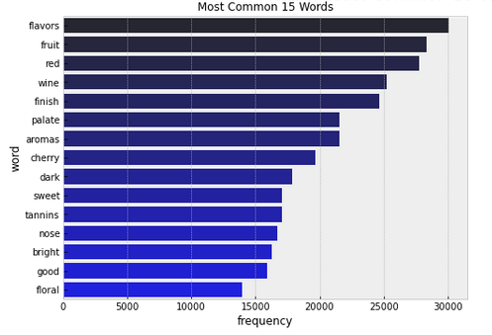
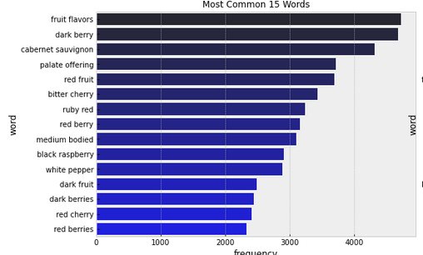
Top 25 Common N-Grams
Most Common Unigrams
Typical Descriptors are seen in the most common words, such as: flavours, fruit, wine, finish
Most Common Bigrams
Descriptors here are common phrases used in tasting notes but surprisingly favour red wines, perhaps representing a skew in the types of wines that are usually tasted

Slide 9
MODELS

Slide 10
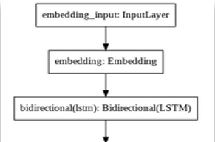


MODEL 1
“Most Basic Model” Dataset: Trained on Wine Spectator Data only ~About 2200 rows of data Topology: 2 LSTM layers stacked on each other Epochs Run: Model ended at 10 after not improving accuracy score Generated text: Aromatic and beautiful harmonious with black tea notes that are in good harmony supported by light tannins and prominent acidity offers a beautiful mouthfeel that coats the palate and invites you back for another sip drink now through 2027 500 cases imported

Slide 11
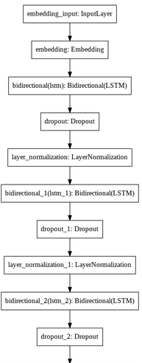

MODEL 2
Dataset: Trained on Wine Spectator Data only ~About 2200 rows of data Topology:
3x
LSTM
Dropout (0.1)
Normalisation
Epochs:
20
Generated text:
Aromatic and fresh with a savory that underscores well defined and plush another show finish drink now through 2027 5

Slide 12
MODEL 3
Dataset: Trained on the Entire Data Set ~About 48,000 rows of data Topology:
3x
LSTM
Dropout (0.1)
Normalisation
Epochs Run:
10 – Each epoch could take 3 hours
Generated text:
Aromatic aromas and dark and dark berry and dark berry and dark berry and dark berry and dark berry and dark berry and dark berry and dark berry and dark berry and dark berry and dark berry and dark berry and dark berry and dark berry and dark berry and dark berry and dark berry and dark berry and dark berry and dark berry and dark berry and dark berry and dark berry and dark berry

Slide 13
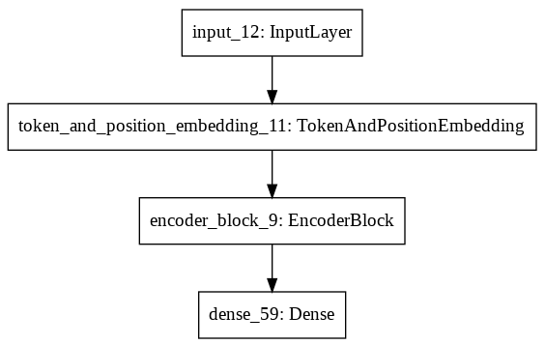
MODEL 4
Transformer Encoder Block
Dataset: Trained on the Entire Data Set ~About 48,000 rows of data Topology:
Token Embedding
Positioning Embedding
4x Encoder Layers:
Multi Head Attention
Dropout
Normalisation
Feed Forward layer
Dropout
Normalisation
Epochs Run:
20
Generated text:
Aromatic and beautiful but the the the on good the and finishes dark and nose of a berry of offering with a to an by this palate

Slide 14
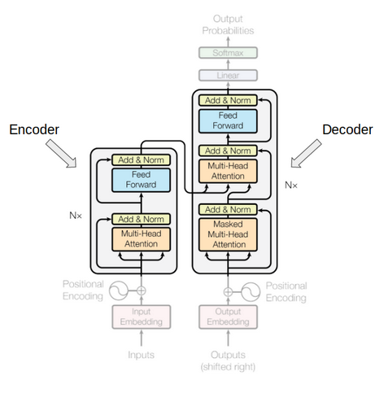
MODEL 5
Pre-trained DistilGPT2 Model
Dataset: Trained on the Entire Data Set ~About 48,000 rows of data Topology:
1/8 the size of GPT 2
6 decoder layers
Epochs Run:
20
Parameters:
Beam paths: 5
Temperature: 0.7
Top_k: 50
Top_p: 1
Generated text:
Aromatic nose combines blackberry, licorice, violet, menthol and wild herbs. Juicy, spicy and intense, with a restrained sweetness to the flavors of dark berries, licorice and bitter chocolate. Finishes with substantial tongue-clean

Slide 15
Model Performance – ‘Aromatic’ Seed
Model | Generated Text
Model 1 | Aromatic and beautiful harmonious with black tea notes that are in good harmony supported by light tannins and prominent acidity offers a beautiful mouthfeel that coats the palate and invites you back for another sip drink now through 2027 500 cases imported
Model 2 | Aromatic and fresh with a savory that underscores well defined and plush another show finish drink now through 2027 5
Model 3 | Aromatic aromas and dark and dark berry and dark berry and dark berry and dark berry and dark berry and dark berry and dark berry and dark berry and dark berry and dark berry and dark berry and dark berry and dark berry and dark berry and dark berry and dark berry and dark berry and dark berry and dark berry and dark berry and dark berry and dark berry and dark berry and dark berry
Model 4 | Aromatic and beautiful but the the the on good the and finishes dark and nose of a berry of offering with a to an by this palate
Model 5 | Aromatic nose combines blackberry, licorice, violet, menthol and wild herbs. Juicy, spicy and intense, with a restrained sweetness to the flavors of dark berries, licorice and bitter chocolate. Finishes with substantial tongue-clean

Slide 16
DistilGPT – Bleu & Rouge
Bleu and Rouge were both used as general metrics but both measure the exact words generated sample vs the ground truth
Only check for the same word, and not for synonyms
Bleu |  | Rouge 1
Cumulative 1-gram | 0.16 | F1 | 0.28
Cumulative 2-gram | 0.27 | Recall | 0.27
Cumulative 3-gram | 0.29 | Precision | 0.30
Cumulative 4-gram | 0.28

Slide 17
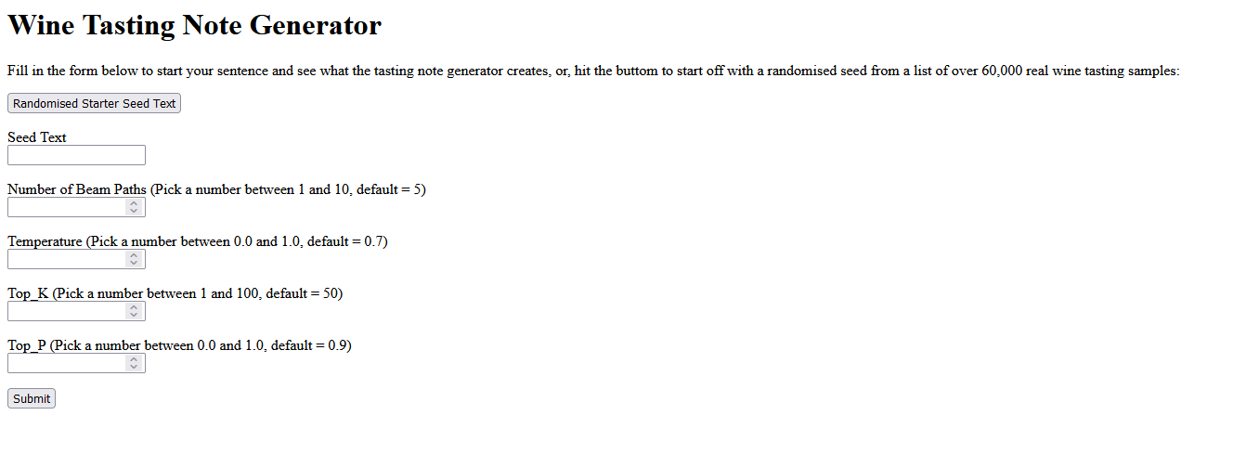
Flask API – Wine Note Generator

Slide 18
Conclusions
The simpler models performed better with LSTMs versus Multi-Attention Head in an encoder block
As the data grew, the accuracy increase slowed due to the increasing complexity (more parameters) and increasing size of the vocabulary, and the model took longer to run – Model 3 took 3 hours per epoch
LSTM models required the data to be split – The sentence “I am a dog” would become:
Multi head Attention was able to examine the relationship of the word to the rest of the sentence, requiring data to only be streamed into 1 X and 1 Y, which allowed a much faster model run time
Words prior | Word Predicted
I | Am
I am | A
I am a | dog

Slide 19
Improving the Model
The LSTM models started to struggle with the larger dataset and the complexity of the output
There is a limit to how much we can increase the number of parameters to track the word meanings and word placement
Instead, to improve the multi head attention model, the introduction of a 1d convolutional layer could be used, with the kernel size to dictate the window of words used
Using pooling layers to reduce parameters may be another possible approach to reduce the complexity of the overall model

Slide 20
Further Upgrades
Controlled Text Generation
Unknown Words
Ideally, notes would be generated based on region and vintage
Pre-Weighting of the two values and their inclusion into the seed text might be one way to do this
Unknown words in the seed text are treated as unknown
A system could be made to reference a larger library like GPT large and pull the closest word in values to replace it in the sentence

Slide 21
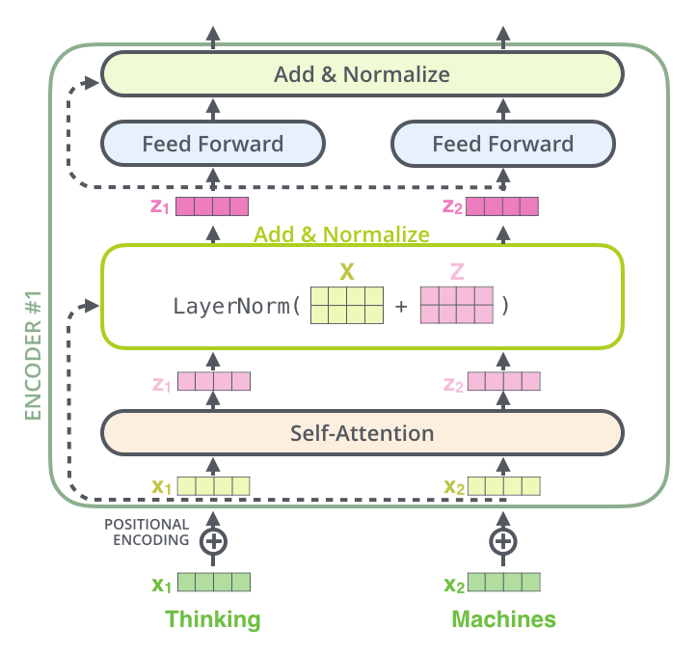
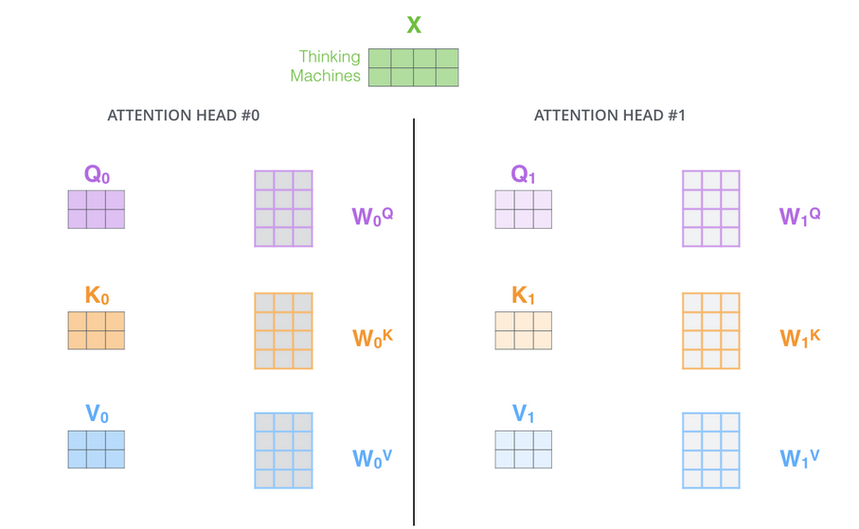
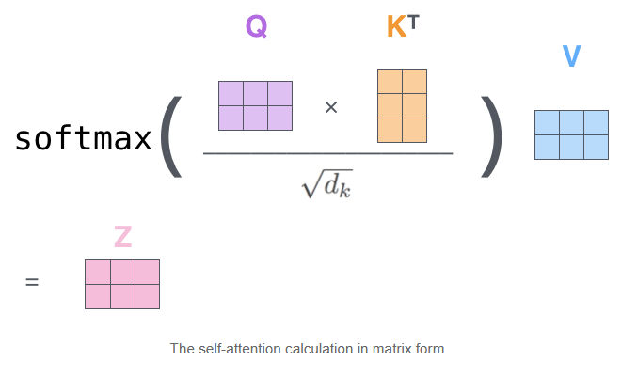
Appendix: Transformer Encoding Block
Multi-Head Attention
Input: ‘Thinking Machines’
Query, Key, Value

Slide 22
DANKE!
Habt ihr noch Fragen?
youremail@freepik.com
+39 620 421 838
yourcompany.com
Bitte lösche diese Folie nicht, es sei denn du bist ein Premium Nutzer

